Slide 1
Image
Notes:
[Sources]
- Πρότυπο: A4.M2 Πολυμέσα-Ήχος(2).pptx
[/Sources]

Slide 2

Today's lesson objectives
Create a new image in GIMP
Recognise the basic selection and editing tools
Combine images using layers and remove the background
Save the project and export a JPEG or GIF image
Notes:
[Sources]
- Θεωρία: pliroforiki_a_lykeiou_simeioseis_2023_2024(2).pdf, σελ. 79
[/Sources]

Slide 3
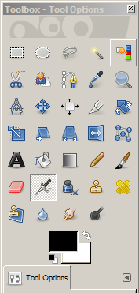
GIMP
free image-editing program
runs on Windows, macOS and Linux
File → Open to open an image
open additional panels through Windows → Dockable Dialogs
Notes:
[Sources]
- Θεωρία: pliroforiki_a_lykeiou_simeioseis_2023_2024(2).pdf, σελ. 79
[/Sources]

Slide 4
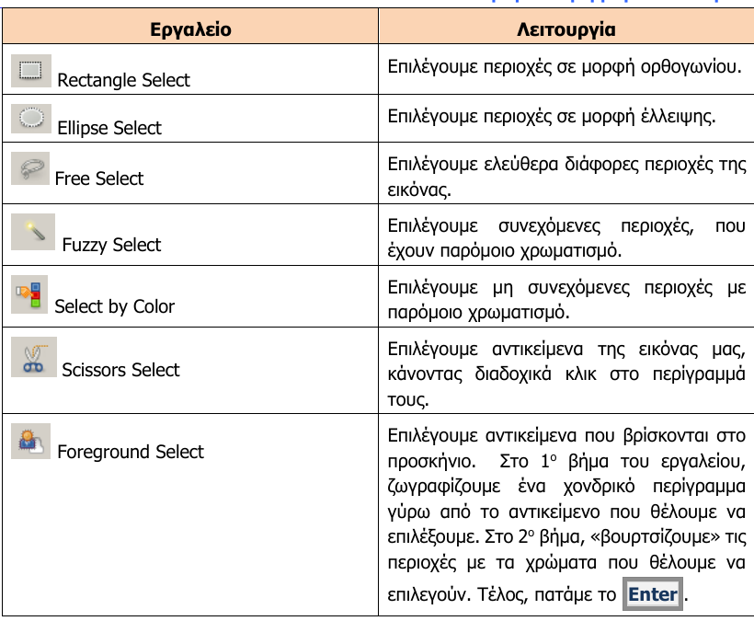
Basic tools
Notes:
[Sources]
- Θεωρία: pliroforiki_a_lykeiou_simeioseis_2023_2024(2).pdf, σελ. 80
[/Sources]

Slide 5
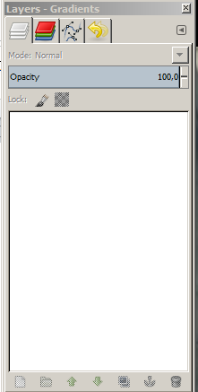
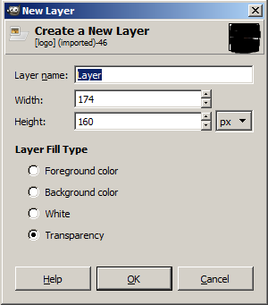
GIMP – Layers
Each element can be placed on a separate layer.
Upper layers cover the layers beneath them.
Layer → New Layer, then choose Transparency for a transparent background.
Layers let us change or remove elements without affecting the original image.
Notes:
[Sources]
- Θεωρία: pliroforiki_a_lykeiou_simeioseis_2023_2024(2).pdf, σελ. 81
[/Sources]

Slide 6
Removing the background
Select the object with a suitable selection tool.
Copy and paste the selection into a new transparent layer.
For a white background: Colors → Color to Alpha.
Use Scale and Move to change the size and position.
Notes:
[Sources]
- Θεωρία: pliroforiki_a_lykeiou_simeioseis_2023_2024(2).pdf, σελ. 79-81
[/Sources]

Slide 7
Saving and exporting
File → Save As
Saves the project as an .xcf file and keeps the layers for future editing.
File → Export To
Creates the final image in JPEG, GIF or PNG format.
First save the project, then export the image.
Notes:
[Sources]
- Θεωρία: pliroforiki_a_lykeiou_simeioseis_2023_2024(2).pdf, σελ. 83
[/Sources]

Slide 8
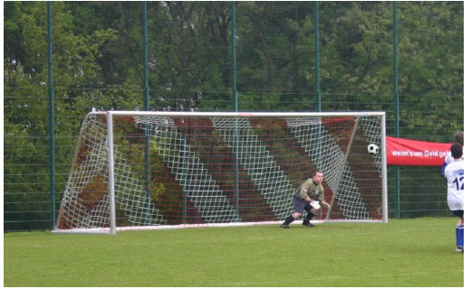
Exercises
In class – Exercise 1 (pp. 57)
Image composition: ask1
Save: ask1.xcf
Export: ask1.jpg
Notes:
[Sources]
- Ασκήσεις: pliroforiki_a_lykeiou_tetradio_ergasion_2023_2024(2).pdf, σελ. 57
[/Sources]

